Slide 1
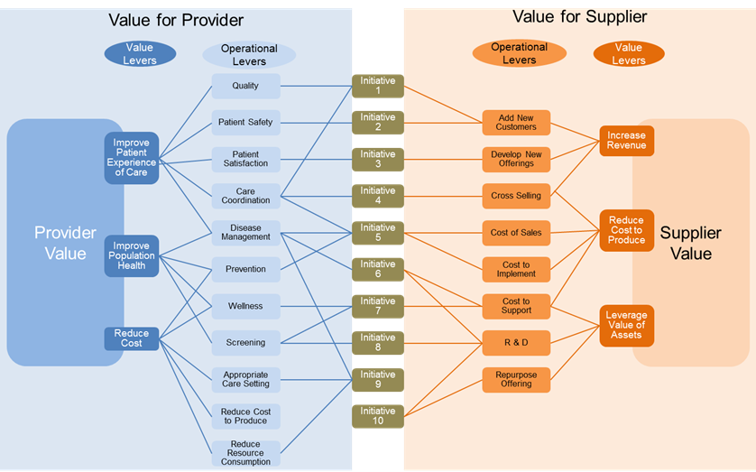
Different Definitions of Value

